Slide 1
Data Collection
Feature Generation
Generate Labels
Machine
Learning

Slide 2
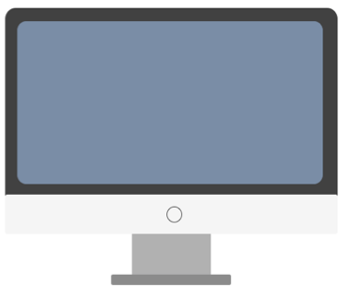
Machine Learning Classifier
svviz
Benchmark SVs
Union VCF
500000+ SVs
Genotype
Variant Type
Length

Slide 3
Machine Learning Classifier
svviz
Benchmark SVs
Union VCF
500000+ SVs
Genotype
Variant Type
Length
Ground Truth

Slide 4
Machine Learning Classifier
svviz
Benchmark SVs
Union VCF
500000+ SVs
Genotype
Variant Type
Length
Ground Truth

Slide 5
Generate labeled data

Slide 6
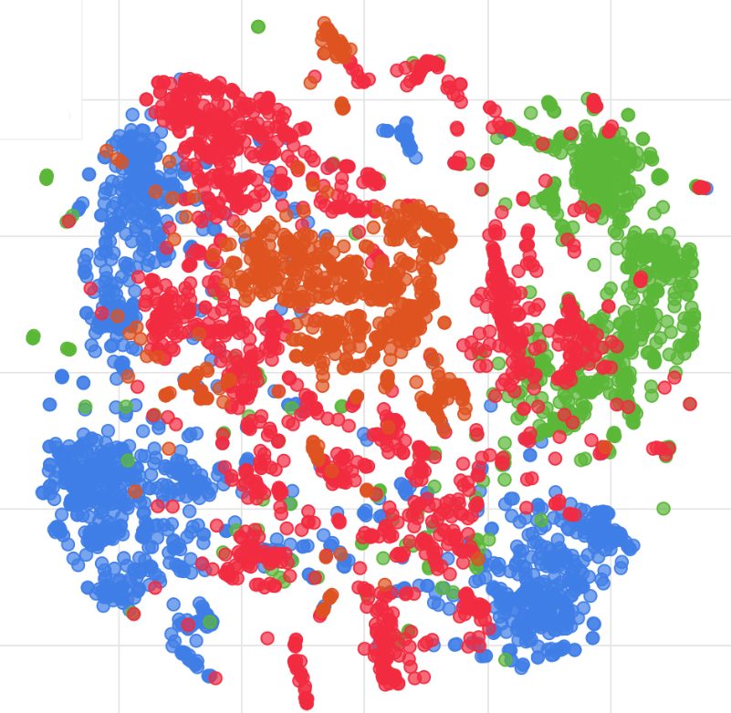
Overview
svviz
5000 Insertions
5000 Deletions

Slide 7
Overview
svviz
5000 Insertions
5000 Deletions

Slide 8
Overview
svviz
5000 Insertions
5000 Deletions
1000 Labeled Data points

Slide 9
Results

Slide 10
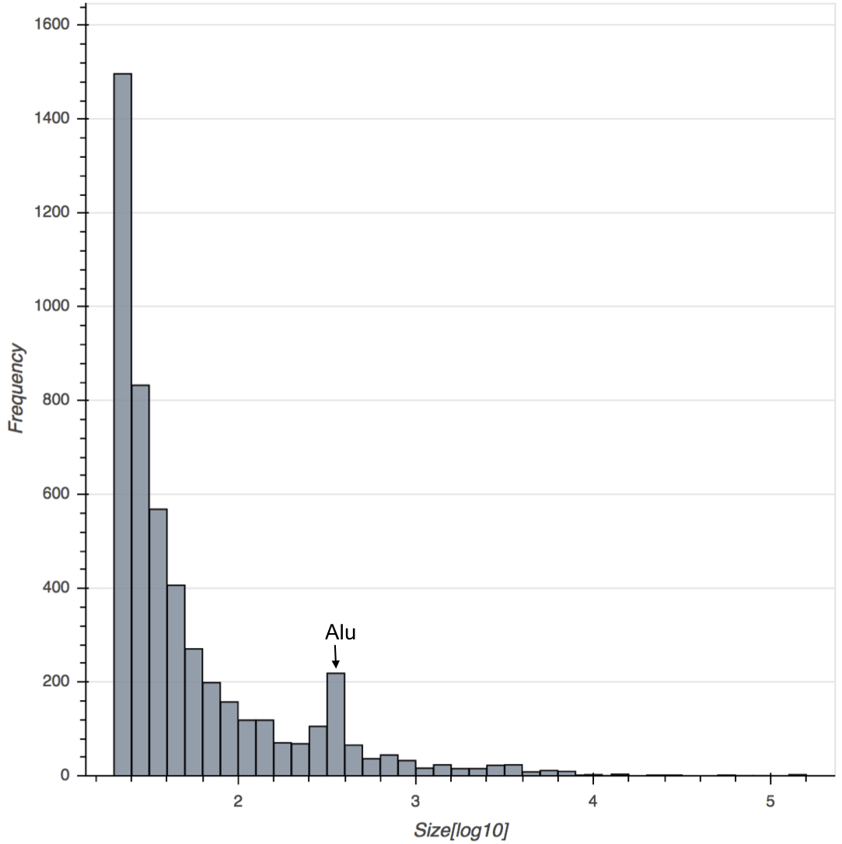
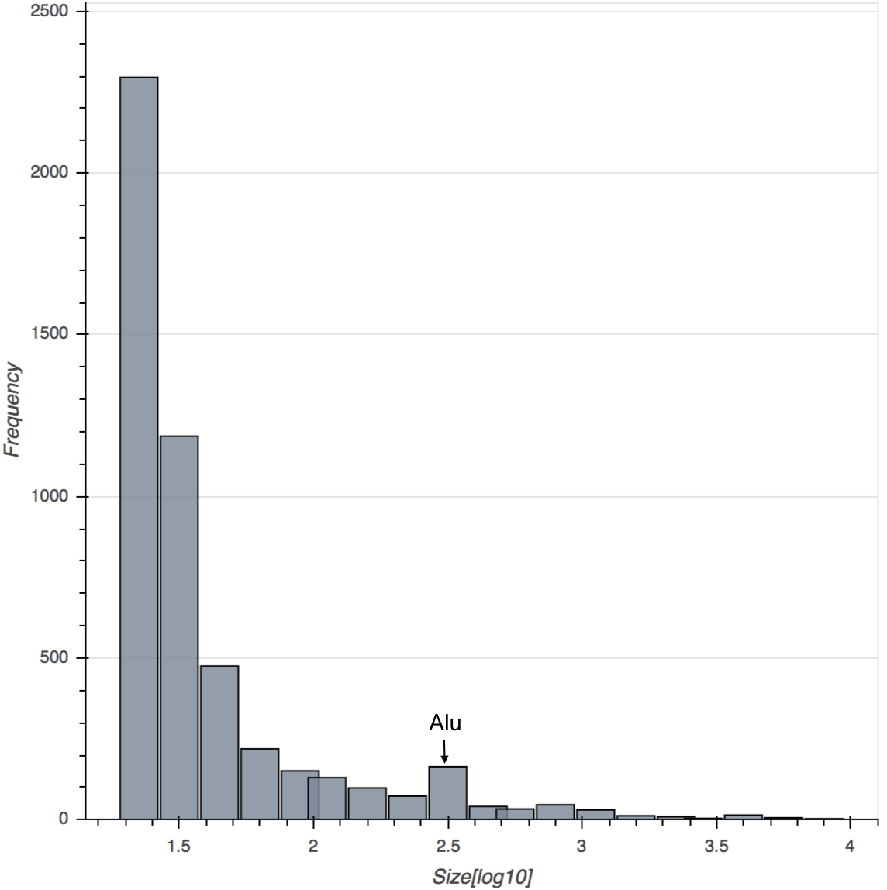
Size
ALU
ALU
Deletions
Insertions

Slide 11
Estimated Consensus GT
Key
0 | Homozygous Reference
1 | Heterozygous Variant
2 | Homozygous Variant
-1 | Undetermined
Deletions
Insertions

Slide 12
Tandem Repeats
Deletions
Insertions

Slide 13
Segmental Duplications
Deletions
Insertions

Slide 14
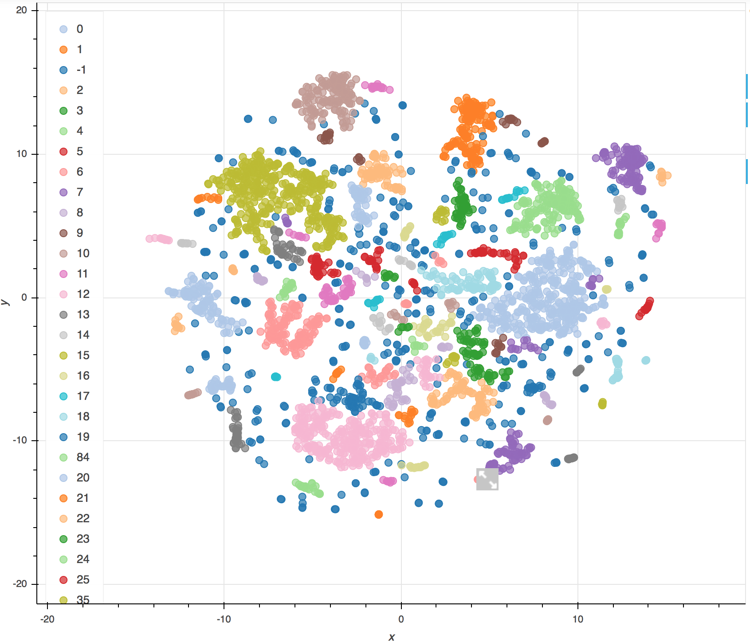
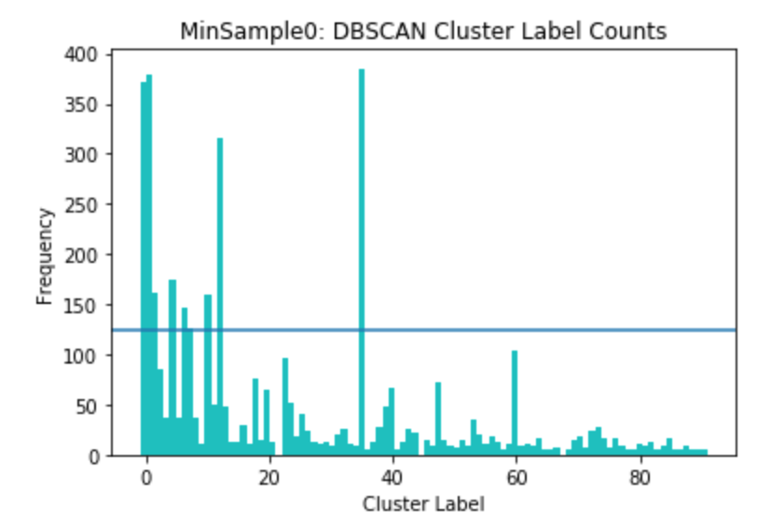
DBSCAN
Deletions

Slide 15
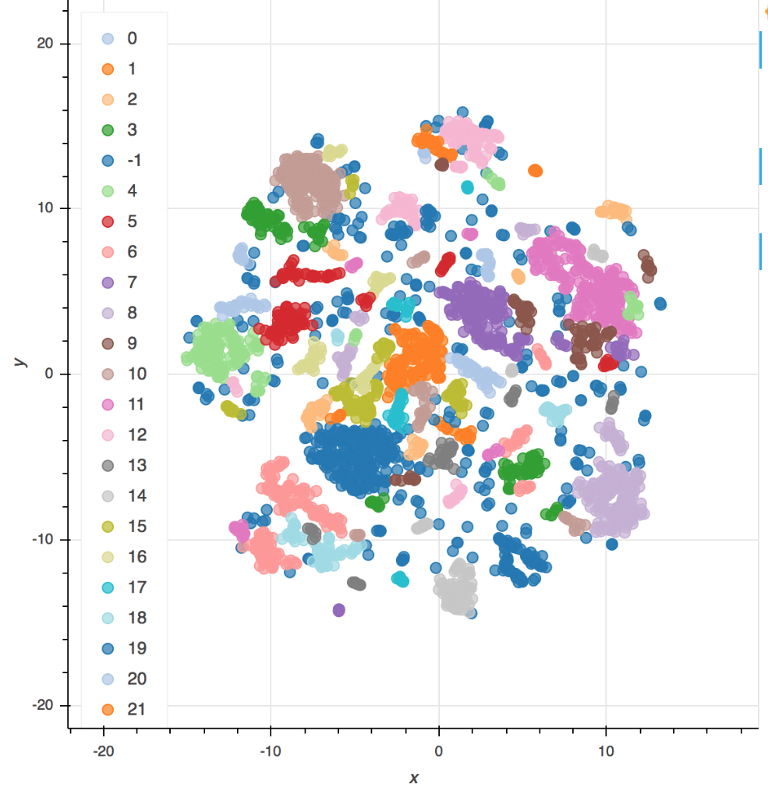
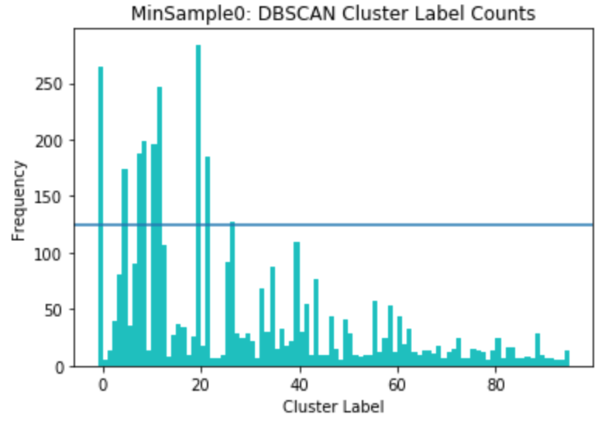
DBSCAN
Insertions

Slide 16
Deletions
Insertions

Slide 17
App Development

Slide 18
Preliminary Machine Learning

Slide 19
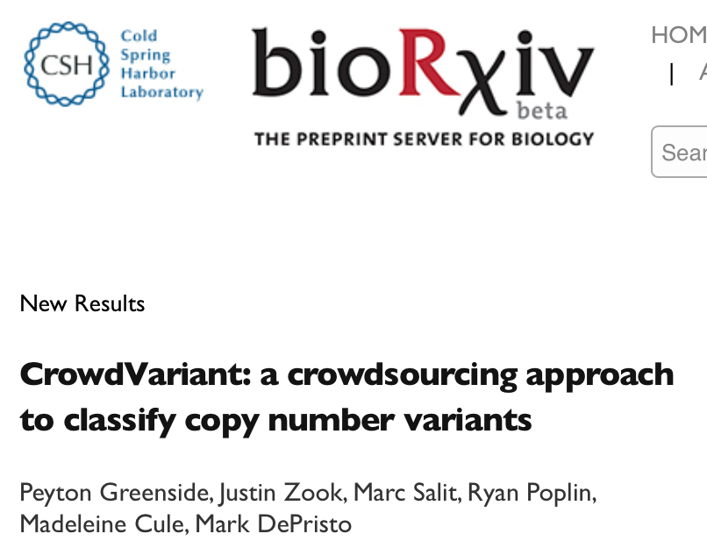
CrowdSourced Labels
1700 + DEL HG002
8 Hom Ref
1097 Het Var
647 Hom Var

Slide 20
HG002 5000 Deletions
Machine Learning Classifier
CrowdVar Data [labeled]
Predict GT Labels

Slide 21
Train Random Forest Classifier
Train-test split [70% Train 30% Test]
Precision Score
0.981619887

Slide 22
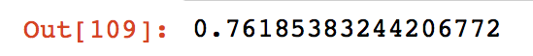
Predict on 5000 Randomly Selected DEL

Slide 23
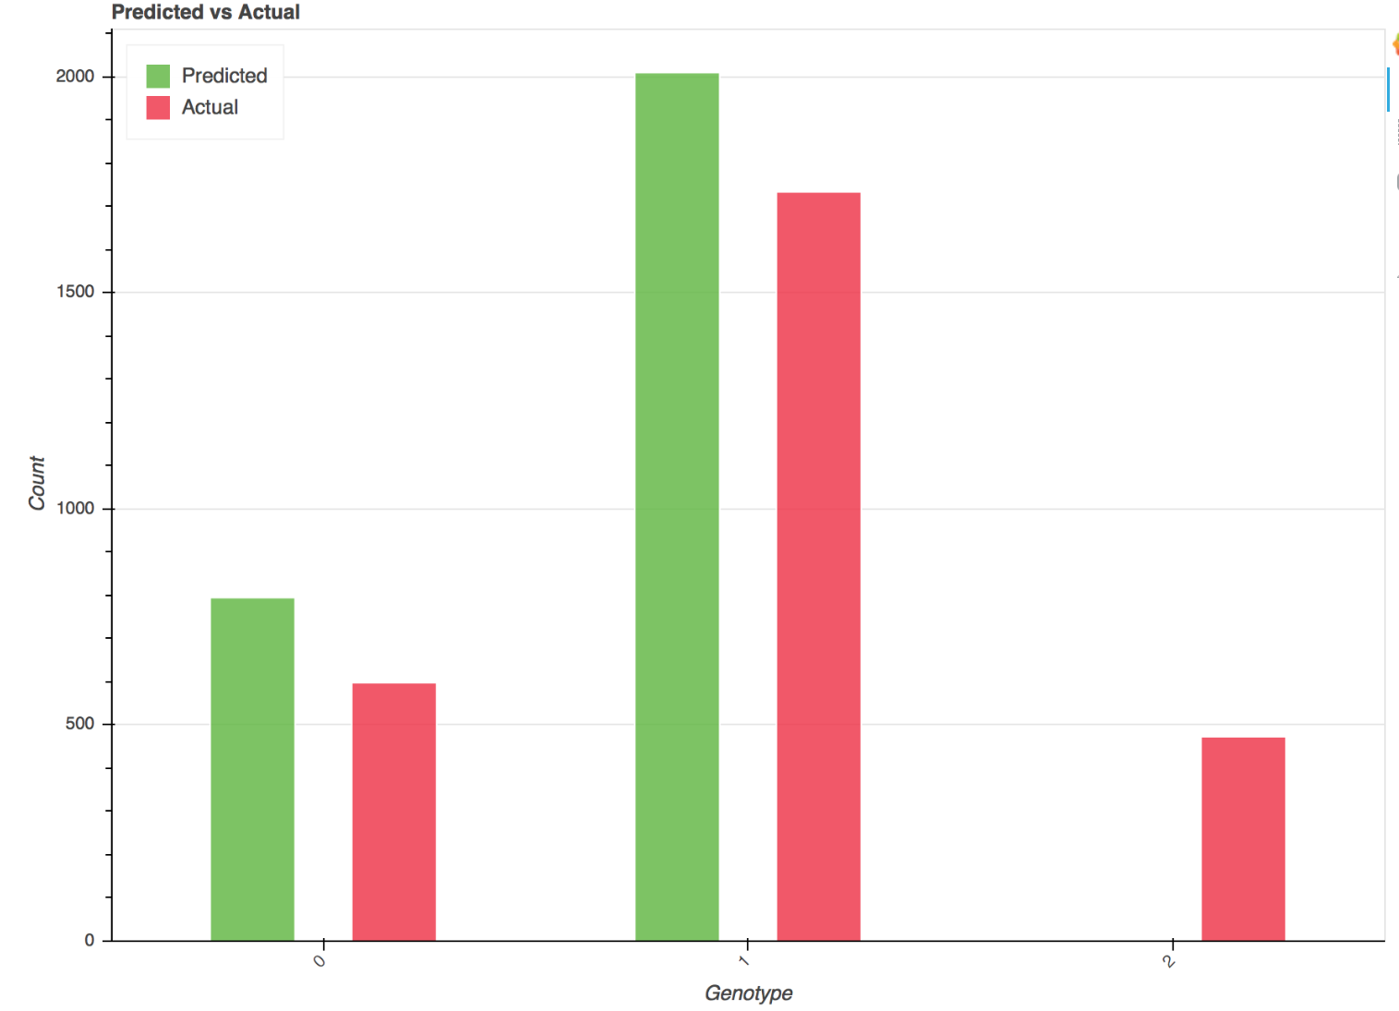
Predict on 5000 Randomly Selected DEL

Slide 24
Trained RF classifier
Train-Test Split
(overall prediction accuracy)
Predict on HG002 given svviz features
Prediction accuracy – 70%, why? Only trained on a few references
Show examples of good and bad matches

